Slide 1

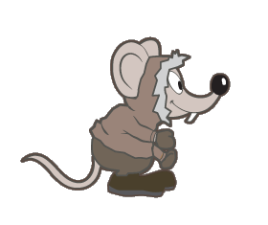
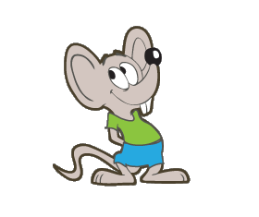
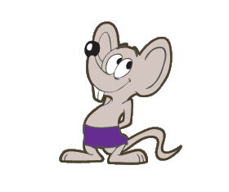
Species Status Assessment
WELCOME!
Notes:
(Monday afternoon 3:00-5:00)
WELCOME to the INTRODUCTION TO SPECIES STATUS ASSESSMENT training course!
This afternoon, we will begin with some introductions, an overview of this week’s goals, a brief review of Species Status Assessments and how they fit into the “Big Picture”, and then TONIGHT, we will have an informal meet & greet after dinner.
Let’s start out with introductions…
Instructors (each introduces themselves to the group)
Participants NEXT SLIDE

Slide 2
Species Status Assessment
INTRODUCTIONS
GOALS
SSA OVERVIEW
BIG PICTURE
MEET & GREET
Notes:
(Monday afternoon 3:00-5:00)
WELCOME to the INTRODUCTION TO SPECIES STATUS ASSESSMENT training course!
This afternoon, we will begin with some introductions, an overview of this week’s goals, a brief review of Species Status Assessments and how they fit into the “Big Picture”, and then TONIGHT, we will have an informal meet & greet after dinner.
Let’s start out with introductions…
Instructors (each introduces themselves to the group)
Participants NEXT SLIDE

Slide 3
Species Status Assessment
Coastal Populations
Beach Bums
Messages in a Bottle (MIB)
Cannibal Cove
Castaways
Paradise Palm Populations
Snowmelt Thicket
Dead Man Dunes
Treasure Grove
Realm of Spirits
Mountain Populations
Misty Mountain
Darlost’s Dome
Notes:
This is the Island Mouse. This week, you will explore the species’ biology to develop an SSA.
The Island Mouse has ten distinct populations, in three ecological settings. You may notice that you have one of these icons on your nametag! Please find others who are in your population and meet with your group for the next FIFTEEN minutes. Introduce yourselves to each other, and quickly decide upon a way that you can introduce YOUR POPULATION to the entire class when we reconvene. Choose a speaker and you will have one minute for your introduction when we reconvene! On your mark, get set, go! (Time about 20 minutes – it may take them a while to find each other…)
Group reconvenes and each population has one minute to introduce themselves to the whole group.

Slide 4
Species Status Assessment
GOALS
  Understand the SSA process
  Be able to create a document from the Assessment
  Learn where information is obtained for each step and where to find help!
Notes:
Our goals for this week are:
(click) To help you understand the process of assessing a species’ status. This is the part where you are gathering information and working through the analysis together. We will be discussing who does what throughout the week, and luckily we have lots of supervisors here who can answer your questions as they arise. Please ask questions as they come to you, because it is likely others are wondering the same thing. We want this week to be a continuous dialogue.
(click) THEN, we will show you have to take the information you have assimilated during the assessment process and turn it into the SSA document. That DOCUMENT will be a living tool for other programs, too…Recovery and Consultation, for example. Can anyone think of how programs other than listing could use the information that is documented in a SSA? Does anyone know yet how other programs will use the information that is documented in a SSA?
(answers could include – Conservation Measures for Recovery Planning, Effects Pathways for consultation, CMs for BMPs, etc…)
(click) …and finally, we hope you will understand where you get information for each part of the SSA process, and that you will know when and where to get help, as appropriate. No one is working on this in a vacuum, and we hope you will feel comfortable using your team and going to the experts when things are complex.

Slide 5
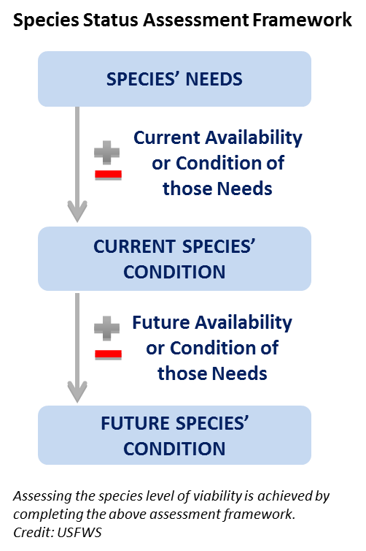
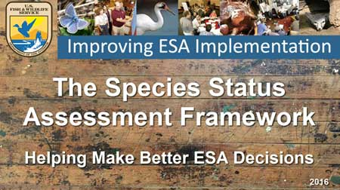
Species Status Assessment
Notes:
IMAGE ON LEFT IS HYPERLINK TO NATHAN’S VIDEO.
Just to get you back in the SSA frame of mind, let’s look at the overview video together. CLICK THE LINK (Load the video onto the laptop you are using.)
During the video, write down ONE burning question that you have…we will collect those at the end of the video and MAKE SURE that we answer them during the week.
After video:
This week, we will spend one whole day on each of the three main parts of the SSA . On Tuesday, we will go in-depth on SPECIES NEEDS. Wednesday is CURRENT CONDITION, and THURSDAY is FUTURE CONDITION. On Friday, we will wrap it up by explaining how it all goes into the document, and we will be introducing you to your group and species that you will work with over the summer to develop a low-analytic draft SSA. DON’T PANIC YET! Lots more to come on this…

Slide 6
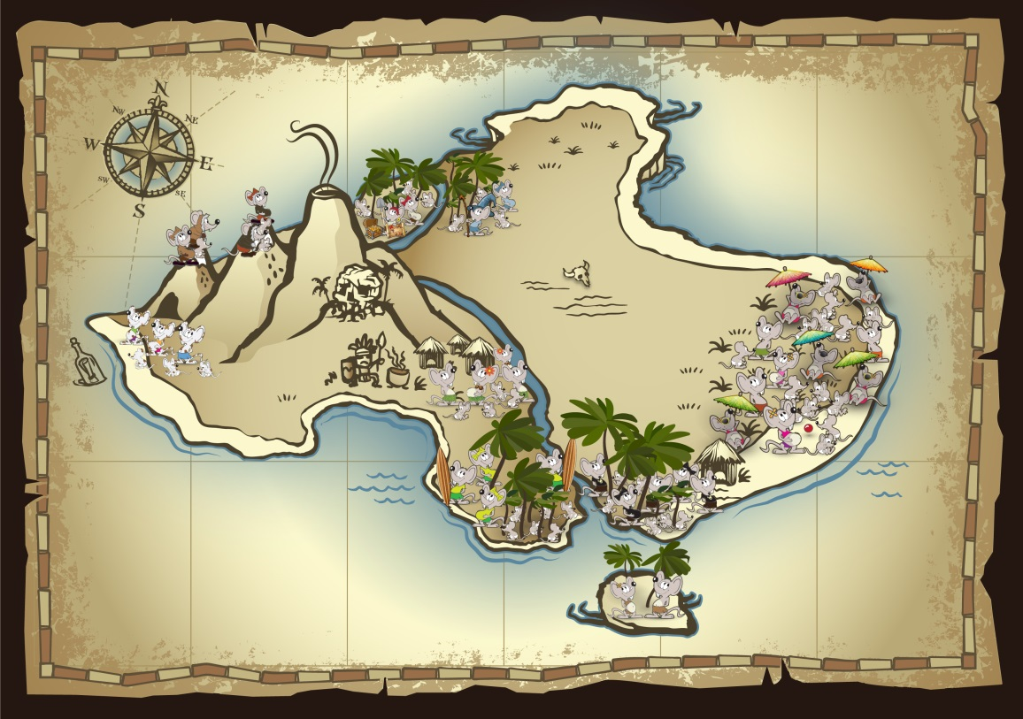
Species Status Assessment
  Viability
    Resiliency
    Redundancy
    Representation
Notes:
So, following from FUTURE CONDITION, we then look at the species’ VIABILITY. Why viability?
- Its what we care about. Keeping plants and animals around.
- Its what we want to manage toward: sustaining populations.
- Its the mission of our agency: conserving.
- It’s foundational to ESA purposes: conserving and recovering.
- Its why we are in the business: not process!
Viability describes the ability for a species to survive in the wild into the future.
We use the “THREE Rs” to describe why species go extinct or remain extant:
(click) Small population sizes that can’t withstand stochastic (random) events. (Resiliency)
(click) Too few populations in too limited an area to withstand catostrophic (large-scale) events. (Redundancy)
(click) Insufficient genetic and ecological variation to adapt to changing environmental conditions. (Representation)
Understanding how the three Rs are woven into an SSA will be a discussion thread throughout this week. We will keep coming back to them, and pointing out where in your thought processes they apply.

Slide 7
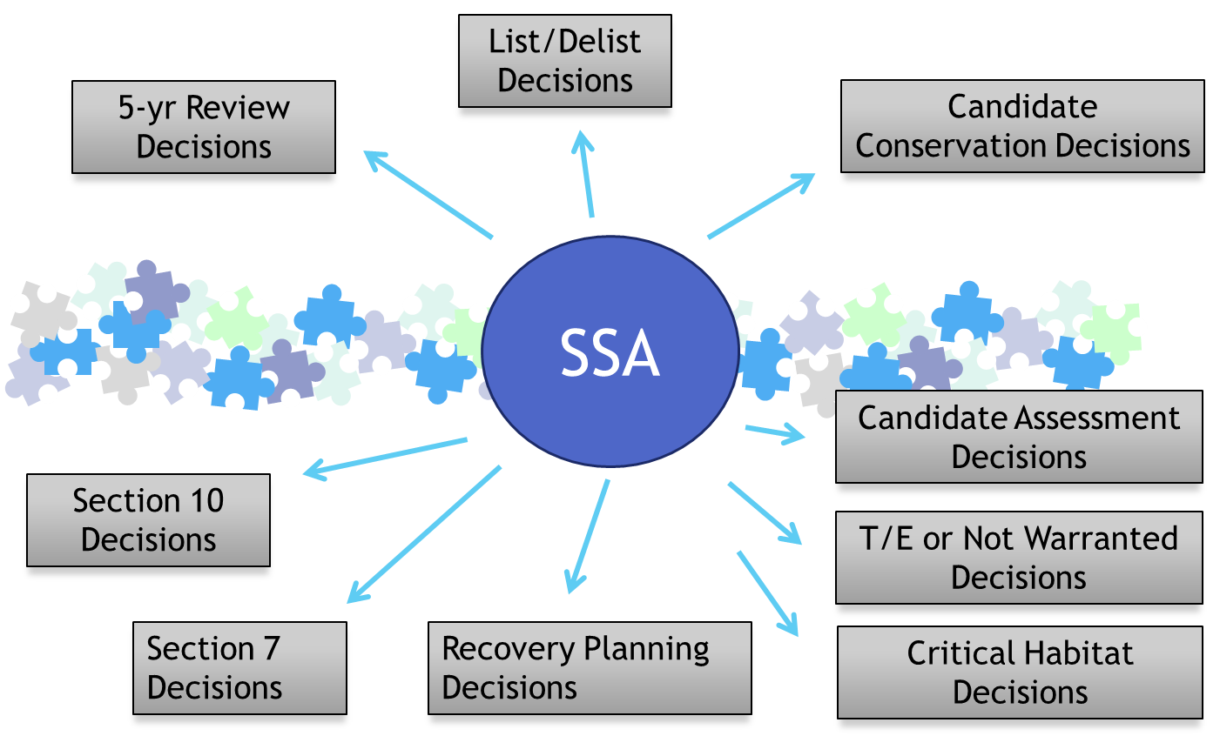
Species Status Assessment
BIG PICTURE
Notes:
The bottom line is, SSAs will inform all ESA decisions. Throughout the week we will point out specific ways that this is so…but for now, know that you will be developing the “hub” of information to be used across all of our programs, to create consistency, efficiency, and conservation for the species.

Slide 8
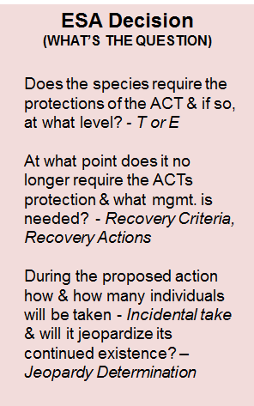
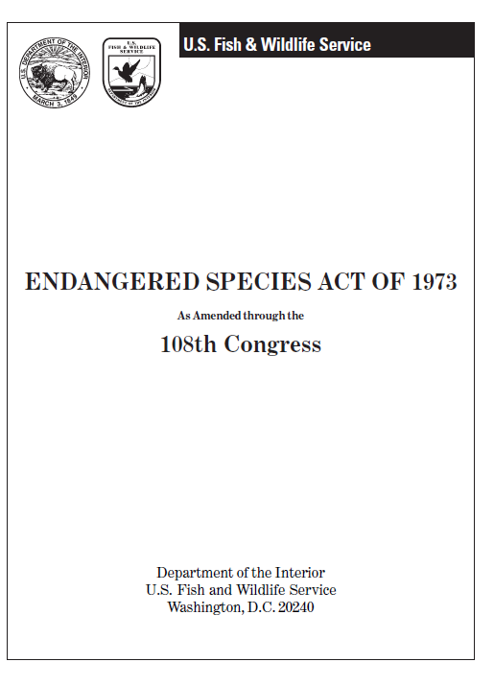
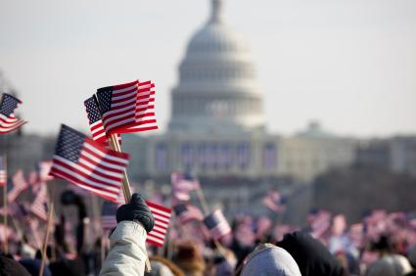
Species Status Assessment
REALLY BIG PICTURE
Notes:
Let’s take a quick step back and look at the REALLY BIG PICTURE.
(CLICK) Where do these decisions come from?
(CLICK) Decisions that we make come from the Endangered Species Act.
But we need to remember that The Endangered Species Act represents society’s values (CLICK) as interpreted by Congress.
The SSA provides the scientific information that will inform these questions. Let’s see how that might work. (Next slide)
The decision maker is informed by the SSA (the species’ risk profile) but must interpret the ESA policies and apply them to the ESA decision at hand. ESA decisions all involve a policy-guided evaluation of risk tolerance under the statutory directives of the ESA. In other words, the decision makers decide what level of risk to the species warrants taking an action—this is a management judgment in light of the case-specific facts and scientific information (species’ risk profile), including uncertainty.

Slide 9
All Levels Needed for ESA Decisions
ESA Decision
(WHAT’S THE QUESTION)
Does the species require the protections of the ACT & if so, at what level? - T or E
At what point does it no longer require the ACTs protection & what mgmt. is needed? - Recovery Criteria, Recovery Actions
During the proposed action how & how many individuals will be taken - Incidental take & will it jeopardize its continued existence? – Jeopardy Determination
SPECIES
pop’n
pop’n
pop’n
individuals
Notes:
Let’s look at this a little closer…
Depending on the ESA decision that you are dealing with, you’ll need to know information at all three biological scales (Species, Population, Individual).
For example, if you are asking the Listing question about whether the species is endangered or threatened, <click> you ultimately want to know the biological status of the species at the species, or range-wide, scale. But to understand the species status, you need to know something about the populations<click> that make up the species, and the individuals <click> that make up the populations.
<click>
If you’re asking questions related to recovery planning for a listed species, again you’re going to be interested mostly in the species level <click> for the biological status, but you very likely may be measuring the status or developing a conservation strategy at the population scale <click>, but you might be planning recovery actions <click> that benefit individuals.
<click>
Finally, if you are working in the consultations arena for a listed species, you might have to estimate the potential for take of individuals <click>, but when you have to decide whether an action could be jeopardizing a species, that would obviously need to be informed at the species level <click>, but you’ll need to understand the impact on populations <click> to explain those species-level effects.
This is why we see the application of the SSA analysis at all three biological scales to help inform our various ESA decision.

Slide 10

Species Status Assessment
Data Availability
Notes:
Instead of providing this list, create it with students on a flip chart and leave it up all week. Leave a slide as a placeholder to do that…titled “where does the information come from to do an SSA?”
Where does the information come from to develop a Species Status Assessment? We will talk about this all week, but in short here are some general sources:
Literature
Published
Reports
Unpublished
Expert Opinion
Formal elicited expert opinion
Personal communication
Targeted research/analysis
New analysis specifically for the SSA
Consider SSAs to be scientific documents and thus subject to peer-review
(CLICK)
Literature
(CLICK)
Expert Opinion
(CLICK)
Targeted Research/ analysis
(CLICK)
…and remember that SSAs are subject to peer review.

Slide 11

What is the SSA?
Science & Analysis
Best available scientific data
SSA Framework
Needs: Indiv's; Pop's; Species
Current Condition
Cause and Effects
Status: Viability (3R’s)
Analytical Methodologies
Conceptual Modeling
Population Modeling
Expert Meetings
etc.
“FRAMEWORK”
ESA Policy
Best available scientific data
Status: Threatened or Endangered
Significant portion of range
5 Factors
Critical Habitat
Take
Jeopardy
Recovery (criteria, objectives, etc.)
etc.
ESA
Decisions
Processes & Products
Project Planning
Timing
People/Resources (Teams)
Making Determinations
Products
SSA "Reports" or output
Decision documents
Federal Register docs
etc.
SSA does NOT necessarily change these (not directly anyway).
SSA WILL change these.
SSA influences these.
Notes:
NATHAN discuss personal perspective…
SSA is the Framework, other benefits flow from that new framework.
Models and meetings and such can support the SSA analysis, but they are not the framework.
Lots of other processes are changing the way we do ESA business (Listing Transformation, REV, etc), and SSA definitely influences them, but that’s not the Framework (not just a new document process).
And SSA is not intended to change policy, although recent SPR policy includes 3R-concepts.

Slide 12

Species Status Assessment
QUESTIONS?
What do YOU want from this training?

Slide 13


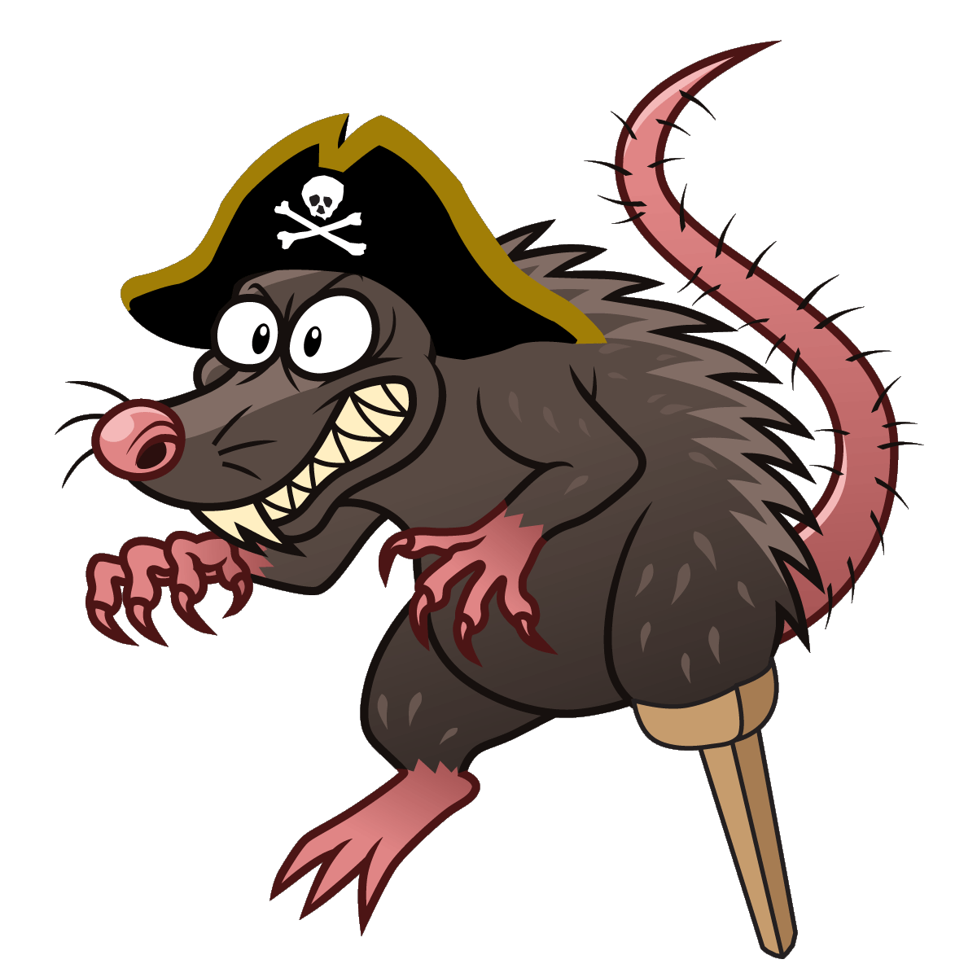
The Island Mouse
Notes:
Instructor introduces us to the basics of the Island Mouse.
After their introduction, HAND OUT (or have students pull out of their notebook back pocket):
The Island Mouse (Zapus islandsonius) parchment sheet
Island Mouse: Resources and Life History Facts
Go over these together. They will be used in the first Exercise.
ALSO, If you have NOT watched the Page Springsnail video, please do so tonight. (Or if time permits, play it at the end of class Monday)

